Slide 1
Routing Convergence
Dr. Yingwu Zhu

Slide 2
Routing Changes due to Topology Changes

Slide 3


Routing Changes
refresh routing states at each router
in response to topology changes
Topology changes: new route to the same place
Host mobility: route to a different place

Slide 4
Two Types of Topology Changes
Planned
Maintenance: shut down a node or link
Energy savings: shut down a node or link
Traffic engineering: change routing configuration
Unplanned Failures
Fiber cut, faulty equipment, power outage, software bugs, …

Slide 5
Detecting Topology Changes
Beaconing
Periodic “hello” messages in both directions
Detect a failure after a few missed “hellos”
Performance trade-offs
Detection delay
Overhead on link bandwidth and CPU
Likelihood of false detection (false positive)
“hello”

Slide 6
What is Routing Convergence?

Slide 7
Convergence
Control plane
All nodes have consistent information, i.e., all routers agree on the same network topology
Data plane
All nodes forward packets in a consistent way
2
3
1
1
4
2
1
5
4
3

Slide 8
Convergence Delay
Sources of convergence delay
Detection latency
Updating control-plane information
Computing and install new forwarding tables
Performance during convergence period
Lost packets due to blackholes and TTL expiry
Looping packets consuming resources
Out-of-order packets reaching the destination
Very bad for VoIP, online gaming, and video

Slide 9
Reducing Convergence Delay
Faster detection
Smaller hello timers, better link-layer technologies
Faster control plane
Flooding immediately
Sending routing messages with high-priority
Faster computation
Faster processors, and incremental computation
Faster forwarding-table update
Data structures supporting incremental updates

Slide 10
Convergence Issues
Link-state routing (OSPF)
Distance vector routing (RIP)
Path vector routing (BGP)

Slide 11
Routing Convergence: Link-State Routing

Slide 12
Transient Disruptions
Detection delay
A node does not detect a failed link immediately
… and forwards data packets into a “blackhole”
Depends on timeout for detecting lost “hellos”
2
3
1
1
4
2
1
5
4
3

Slide 13
Transient Disruptions
Inconsistent link-state database
Some routers know about failure before others
Inconsistent paths cause transient forwarding loops
2
2
3
1
3
1
1
1
4
4
2
1
2
1
5
4
3
4
3

Slide 14
Slow Convergence in Distance-Vector Routing

Slide 15
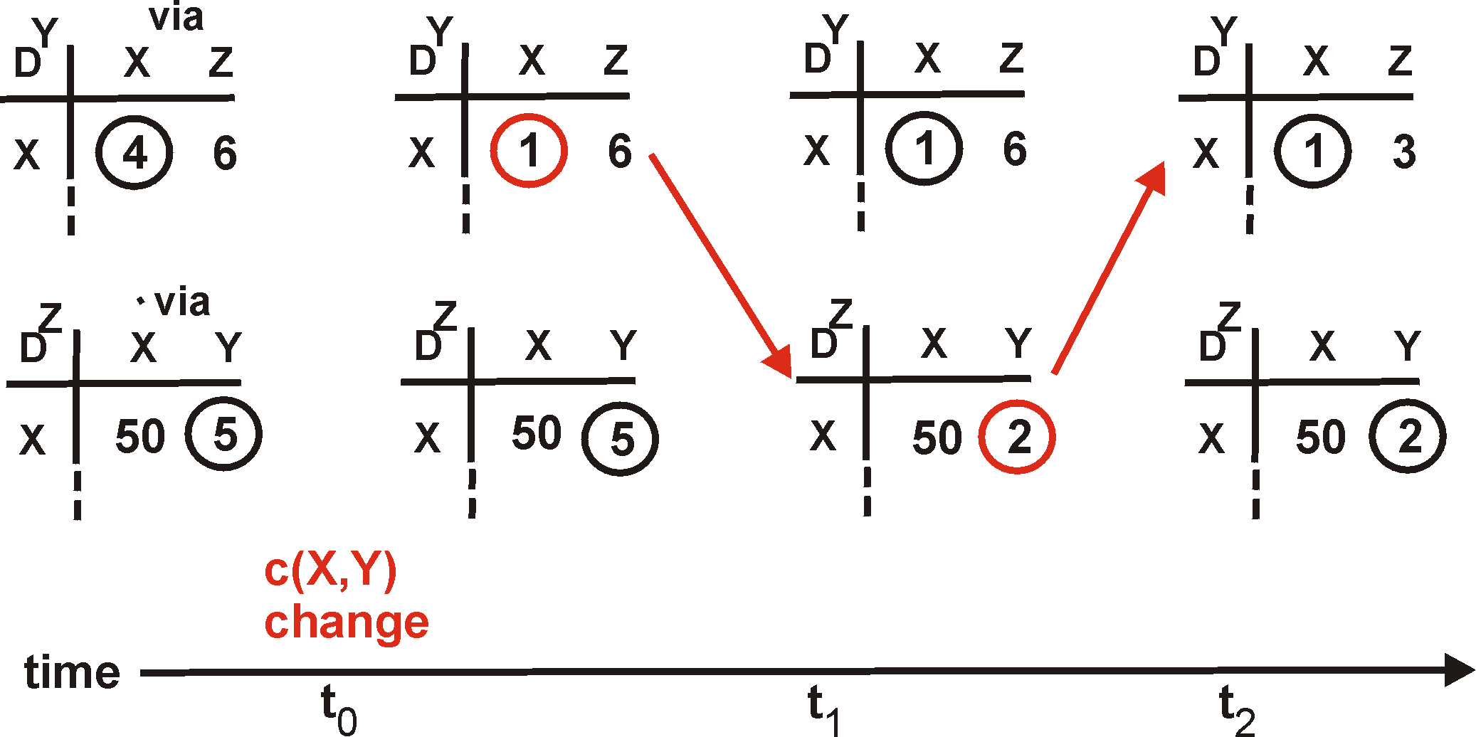
Distance Vector: Link Cost Changes
1
Y
Link cost decreases and recovery
Node updates the distance table
If cost changes in least cost path, notify neighbors
4
1
X
Z
50
D^{Y} = Distances known to Y

Slide 16
Distance Vector: Link Cost Changes
1
Y
Link cost decreases and recovery
Node updates the distance table
If cost changes in least cost path, notify neighbors
4
1
X
Z
50
D^{Y} = Distances known to Y

Slide 17
Distance Vector: Link Cost Changes
1
Y
Link cost decreases and recovery
Node updates the distance table
If cost changes in least cost path, notify neighbors
4
1
X
Z
50
D^{Y} = Distances known to Y
“good
news
travels
fast”

Slide 18
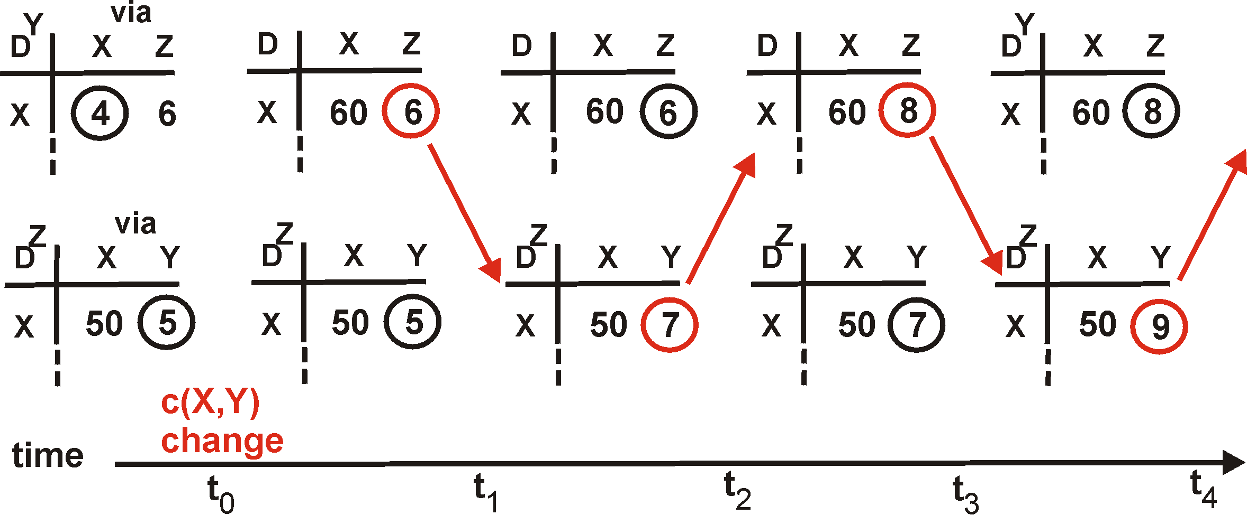
Distance Vector: Link Cost Changes
Link cost increases and failures
Bad news travels slowly
“Count to infinity” problem!
60
Y
4
1
X
Z
50

Slide 19
Distance Vector: Link Cost Changes
Link cost increases and failures
Bad news travels slowly
“Count to infinity” problem!
60
Y
4
1
X
Z
50
algorithm
continues
on!

Slide 20
Solutions to “Count to Infinity” Problem

Slide 21
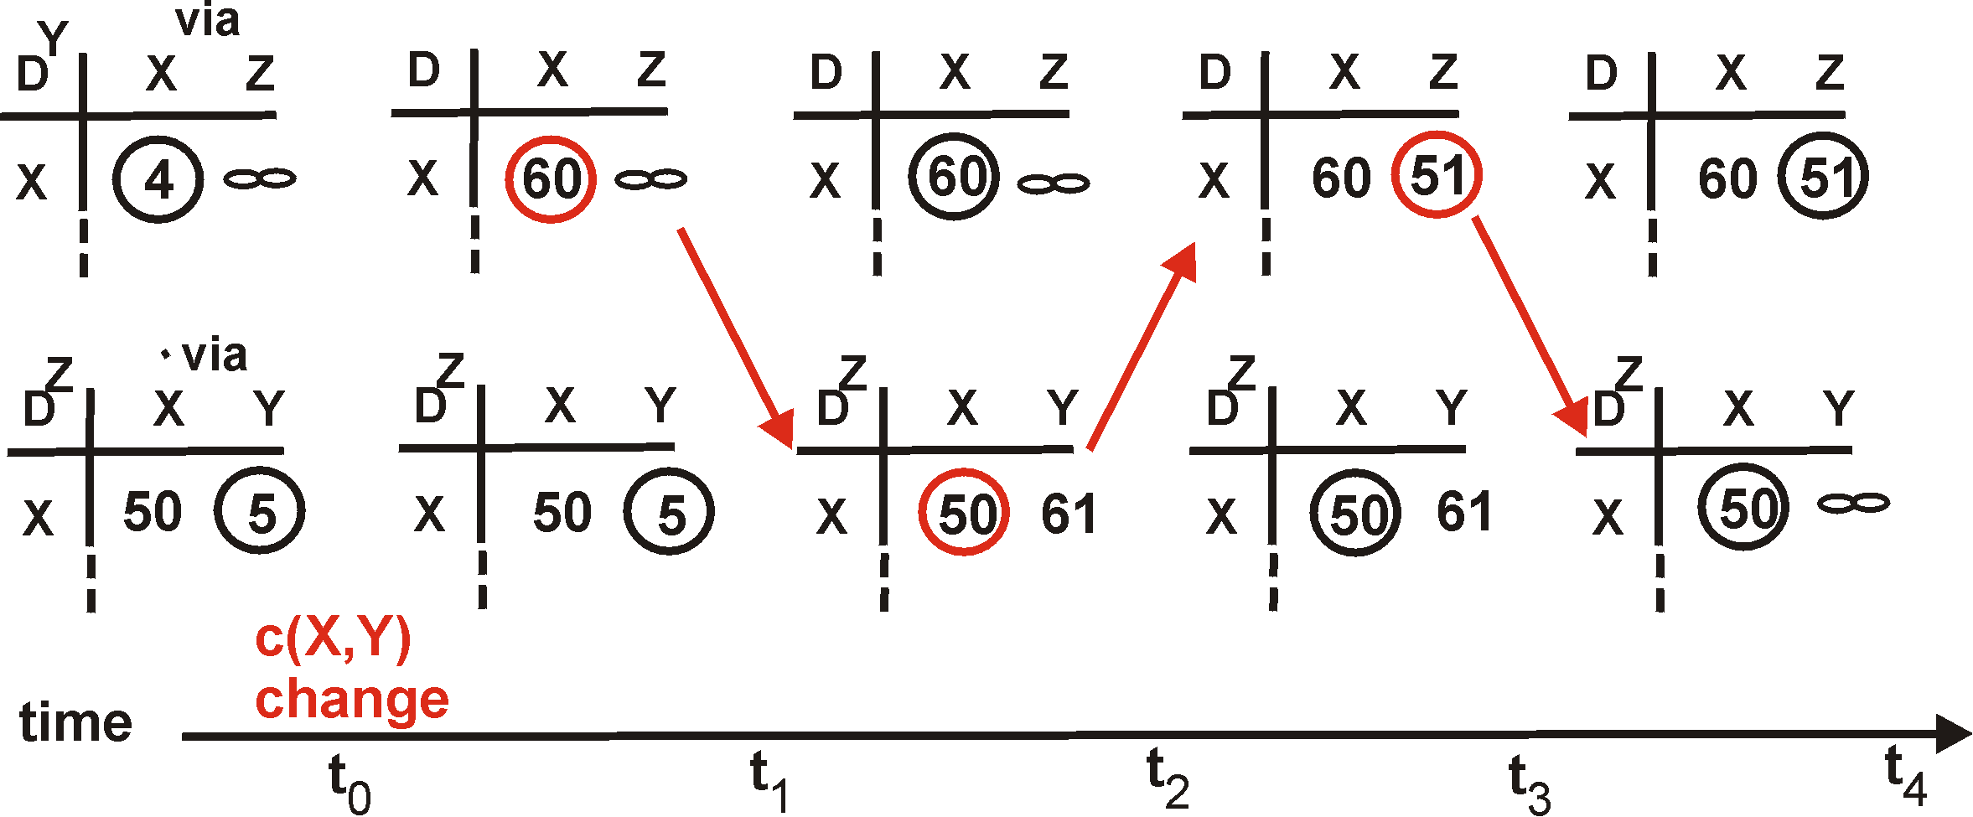
Solution #1: Poison Reverse
If Z routes through Y to get to X :
Z tells Y its (Z’s) distance to X is infinite (so Y won’t route to X via Z)
Still, can have problems in larger networks
60
Y
4
1
X
Z
50
algorithm
terminates

Slide 22
Solution #2: Redefining Infinity
Avoid “counting to infinity”
By making “infinity” smaller!
Routing Information Protocol (RIP)
All links have cost 1
Valid path distances of 1 through 15
… with 16 representing infinity
Used mainly in small networks

Slide 23
Reducing Convergence Time With Path-Vector Routing (e.g., Border Gateway Protocol)

Slide 24

Path-Vector Routing
Extension of distance-vector routing
Support flexible routing policies
Avoid count-to-infinity problem
Key idea: advertise the entire path
Distance vector: send distance metric per dest d
Path vector: send the entire path for each dest d
“d: path (2,1)”
“d: path (1)”
3
2
1
data traffic
data traffic
d

Slide 25
Faster Loop Detection
Node can easily detect a loop
Look for its own node identifier in the path
E.g., node 1 sees itself in the path “3, 2, 1”
Node can simply discard paths with loops
E.g., node 1 simply discards the advertisement
“d: path (2,1)”
“d: path (1)”
3
2
1
“d: path (3,2,1)”

Slide 26
BGP Session Failure
BGP runs over TCP
BGP only sends updates when changes occur
TCP doesn’t detect lost connectivity on its own
Detecting a failure
Keep-alive: 60 seconds
Hold timer: 180 seconds
Reacting to a failure
Discard all routes learned from neighbor
Send new updates for any routes that change
AS1
AS2

Slide 27
Routing Change: Before and After
Forwarding paths
0
0
(1,0)
(2,0)
(2,0)
(1,2,0)
1
2
1
2
(3,1,0)
(3,2,0)
3
3
27

Slide 28
Routing Change: Path Exploration
AS 1
Delete the route (1,0)
Switch to next route (1,2,0)
Send route (1,2,0) to AS 3
AS 3
Sees (1,2,0) replace (1,0)
Compares to route (2,0)
Switches to using AS 2
0
(2,0)
(1,2,0)
1
2
(3,2,0)
3

Slide 29
Routing Change: Path Exploration
(2,0)
(2,1,0)
(2,3,0)
(2,1,3,0)
(1,0)
(1,2,0)
(1,3,0)
Initial: All AS use direct
Then destination 0 dies
All ASes lose direct path
All switch to longer paths
Eventually withdrawn
How many intermediate routes following (2,0) withdrawal until no route known to 2?
(2,0) → (2,1,0) → (2,3,0) → (2,1,3,0) → null
1
2
0
3
(3,0)
(3,1,0)
(3,2,0)

Slide 30
BGP Converges Slowly
Path vector avoids count-to-infinity
But, ASes still must explore many alternate paths to find highest-ranked available path
Fortunately, in practice
Most popular destinations have stable BGP routes
Most instability lies in a few unpopular destinations
Still, lower BGP convergence delay is a goal
Can be tens of seconds to tens of minutes
30

Slide 31
BGP Instability
31

Slide 32
Stable Paths Problem (SPP)
Does every node have a stable route to one destination node?

Slide 33
Stable Paths Problem (SPP) Instance
Node
BGP-speaking router
Node 0 is destination
Edge
BGP adjacency
Permitted paths
Set of routes to 0 at each node (this set always contains “null path”, which is always the least preferred, not shown here)
Ranking of the paths
2 1 0
2 0
2
5
5 2 1 0
2
4 2 0
4 3 0
4
0
1
3
3 0
1
1 3 0
1 0
most preferred
…
least preferred
33

Slide 34
A Solution to a Stable Paths Problem
A solution is an assignment of permitted paths to each node such that
node u’s assigned path is either the null path or is a path uwP, where wP is assigned to node w and {u,w} is an edge in the graph
each node is assigned the highest ranked path among those consistent with the paths assigned to its neighbors.
2 1 0
2 0
2
5
5 2 1 0
2
4 2 0
4 3 0
4
0
1
3
3 0
1
1 3 0
1 0
most preferred
…
least preferred
34

Slide 35
Example: SHORTEST1
2 0
2 1 0
1 0
1 3 0
1
2
0
4 3 0
4 2 0
4
3 0
3

Slide 36
Example: SHORTEST1 (Solution)
2 0
2 1 0
1 0
1 3 0
1
2
0
4 3 0
4 2 0
4
3 0
3

Slide 37
Example: SHORTEST2
2 0
2 1 0
1 0
1 3 0
1
2
0
4 2 0
4 3 0
4
3 0
3

Slide 38
Example: SHORTEST2 (Solution)
2 0
2 1 0
1 0
1 3 0
1
2
0
4 2 0
4 3 0
4
3
3 0

Slide 39
Example: GOOD GADGET
2 1 0
2 0
1 3 0
1 0
1
2
0
4 3 0
4 2 0
4
3 0
3

Slide 40
Example: GOOD GADGET (Solution)
2 1 0
2 0
1 3 0
1 0
1
2
0
4 3 0
4 2 0
4
3 0
3

Slide 41
A Stable Paths Problem may have multiple solutions
1 2 0
1 0
1 2 0
1 0
1 2 0
1 0
1
1
1
0
0
0
2
2
2
2 1 0
2 0
2 1 0
2 0
2 1 0
2 0
First solution
Second solution
DISAGREE

Slide 42
Example: NAUGHTY GADGET
2 1 0
2 0
1 3 0
1 0
1
2
0
4 3 0
4 2 0
4
3 4 2 0
3 0
3

Slide 43
Example: NAUGHTY GADGET (Solution 1)
2 1 0
2 0
1 3 0
1 0
1
2
0
4 3 0
4 2 0
4
3 4 2 0
3 0
3

Slide 44
Example: NAUGHTY GADGET (Solution 2)
2 1 0
2 0
1 3 0
1 0
1
2
0
4 3 0
4 2 0
4
3 4 2 0
3 0
3

Slide 45
SPP helps explain possibility of BGP divergence
BGP is not guaranteed to converge to a stable routing. Policy inconsistencies can lead to “livelock” protocol oscillations.
See “Persistent Route Oscillations in Inter-domain Routing” by K. Varadhan, R. Govindan, and D. Estrin. ISI report, 1996
The SPP view :
Solvable
Can Diverge
must converge
must diverge
Notes:
If you can’t solve this problem, then you don’t understand the protocol

Slide 46
Example: NAUGHTY GADGET
2 1 0
2 0
1 3 0
1 0
1
2
0
4 3 0
4 2 0
4
3 4 2 0
3 0
3

Slide 47
Example: BAD GADGET
2 1 0
2 0
1 3 0
1 0
1
2
0
4 2 0
4 3 0
4
3 4 2 0
3 0
3

Slide 48
Example: BAD GADGET
2 1 0
2 0
1 3 0
1 0
1
2
0
4 2 0
4 3 0
4
3 4 2 0
3 0
3
2 chooses (2 0)
4 chooses (4 2 0)
3 chooses (3 4 2 0)
1 chooses (1 0)

Slide 49
Example: BAD GADGET
2 1 0
2 0
1 3 0
1 0
1
2
0
4 2 0
4 3 0
4
3 4 2 0
3 0
3
… 2 chooses (2 1 0) …

Slide 50
Example: BAD GADGET
2 1 0
2 0
1 3 0
1 0
1
2
0
4 2 0
4 3 0
4
3 4 2 0
3 0
3
… 3 chooses (3 0) …

Slide 51
Example: BAD GADGET
2 1 0
2 0
1 3 0
1 0
1
2
0
4 2 0
4 3 0
4
3 4 2 0
3 0
3
… 1 chooses (1 3 0) …

Slide 52
Example: BAD GADGET
2 1 0
2 0
1 3 0
1 0
1
2
0
4 2 0
4 3 0
4
3 4 2 0
3 0
3
… 2 chooses (2 0) …

Slide 53
Example: BAD GADGET
2 1 0
2 0
1 3 0
1 0
1
2
0
4 2 0
4 3 0
4
3 4 2 0
3 0
3
… 3 chooses (3 4 2 0) …
LOOP !

Slide 54
BAD GADGET : No Solution
With a BGP-like
protocol, each node
will do the best it
can, so at least one
node will always have
the opportunity to
improve its path.
Result :
persistent
oscillation.
2 1 0
2 0
2
4 2 0
4 3 0
4
0
1
3
3 4 2 0
3 0
1 3 0
1 0

Slide 55
SURPRISE : Beware of Backup Policies
2 1 0
2 0
Becomes BAD GADGET if link
(4, 0) goes down.
2
4 0
4 2 0
4 3 0
BGP is not robust :
it is not guaranteed
to recover from
network failures.
4
0
1
3
3 4 2 0
3 0
1 3 0
1 0

Slide 56
PRECARIOUS
Has a solution, but can get “trapped”
4
4 3 1 0
4 5 3 1 2 0
4 3 1 2 0
1 2 0
1 0
1
3 1 0
3 1 2 0
3
0
5
6
2
2 1 0
2 0
5 3 1 0
5 6 3 1 2 0
5 3 1 2 0
6 3 1 0
6 4 3 1 2 0
6 3 1 2 0
This part has a solution only
when node 1 is assigned the
direct path (1 0).
As with DISAGREE, this part
has two distinct solutions

Slide 57
Theoretical Results
The problem of determining whether an instance of stable paths problem is solvable is NP-complete
Shortest path route selection is provably safe

Slide 58
Convergence in the real-world?
[Labovitz99] Experimental results from two year study which measured 150,000 BGP faults injected into peering sessions at several IXPs
Found
Internet averages 3 minutes to converge after failover
Some multihomed failovers (short to long ASPath) require 15 minutes

Slide 59
BGP Convergence Example
R
AS2
AS3
AS0
AS1
*B R via AS3
B R via AS1,AS3
B R via AS2,AS3
*B R via AS3
B R via AS0,AS3
B R via AS2,AS3
*B R via AS3
B R via AS0,AS3
B R via AS1,AS3
*
*
*
*B R via 013
B R via 103
*B R via 203
AS0
AS1
AS2

Slide 60
Convergence Result
If we assume
unbounded delay on BGP processing and propagation
Full BGP mesh BGP peers
Constrained shortest path first selection algorithm
BGP is O(N!), where N number of default-free BGP speakers
There exists possible ordering of messages such that BGP will explore all possible ASPaths of all possible lengths

Slide 61
An SPP May Have No Solution
2 1 0
2 0
2
4
0
3 2 0
3 0
1 3 0
1 0
1
3
3
61

Slide 62
Avoiding BGP Instability
Detecting conflicting policies
Computationally expensive
Requires too much cooperation
Detecting oscillations
Observing the repetitive BGP routing messages
Restricted routing policies and topologies
Policies based on business relationships
62

Slide 63
AS (Autonomous System) Business Relationships
63

Slide 64
Customer-Provider Relationship
Customer pays provider for access to Internet
Provider exports its customer routes to everybody
Customer exports provider routes only to its customers
Traffic to customer
Traffic from customer
d
provider
advertisements
provider
traffic
customer
d
customer
64

Slide 65
Peer-Peer Relationship
Peers exchange traffic between their customers
AS exports only customer routes to a peer
AS exports a peer’s routes only to its customers
Traffic to/from the peer and its customers
advertisements
peer
peer
traffic
d
65

Slide 66
Hierarchical AS Relationships
Provider-customer graph is directed and acyclic
If u is a customer of v and v is a customer of w
… then w is not a customer of u
w
v
u
66

Slide 67
Valid and Invalid Paths
Path 1 2 d
Path 7 d
Path 5 8 d
Path 6 4 3 d
Path 8 5 d
Path 6 5 d
Path 1 4 3 d
A) Valid B) Invalid
1
2
3
4
d
5
6
Provider-Customer
Peer-Peer
7
8
67

Slide 68
Valid and Invalid Paths
Valid paths: “1 2 d” and “7 d”
Invalid path: “5 8 d”
1
2
3
4
d
5
6
Provider-Customer
Peer-Peer
7
8
68

Slide 69
Valid and Invalid Paths
Valid paths: “6 4 3 d” and “8 5 d”
Invalid paths: “6 5 d” and “1 4 3 d”
1
2
3
4
d
5
6
Provider-Customer
Peer-Peer
7
8
69

Slide 70
Local Control, Global Stability: “Gao-Rexford Conditions”
Route export
Don’t export routes learned from a peer or provider to another peer or provider
Global topology
Provider-customer relationship graph is acyclic
E.g., my customer’s customer is not my provider
Route selection
Prefer routes through customers over routes through peers and providers
Guaranteed to converge to unique, stable solution
70

Slide 71
Conclusions
The only constant is change
Planned topology and configuration changes
Unplanned failure and recovery
Routing-protocol convergence
Transient period of disagreement
Blackholes, loops, and out-of-order packets
Routing instability
Permanent conflicts in routing policy
Leading to bi-stability or oscillation
71

